Slide 1

DRIVER’S DROWSINESS PREVENTION
PREPARED BY:
. Prabh Simran Singh(09013202720)
Mandeep Kaur(07513202720)
. Jaskirat Singh Bedi(06413202720)
Kavya Bisht(07313202720)
GUIDED BY:
Dr. Ashish Bhardwaj

Slide 2
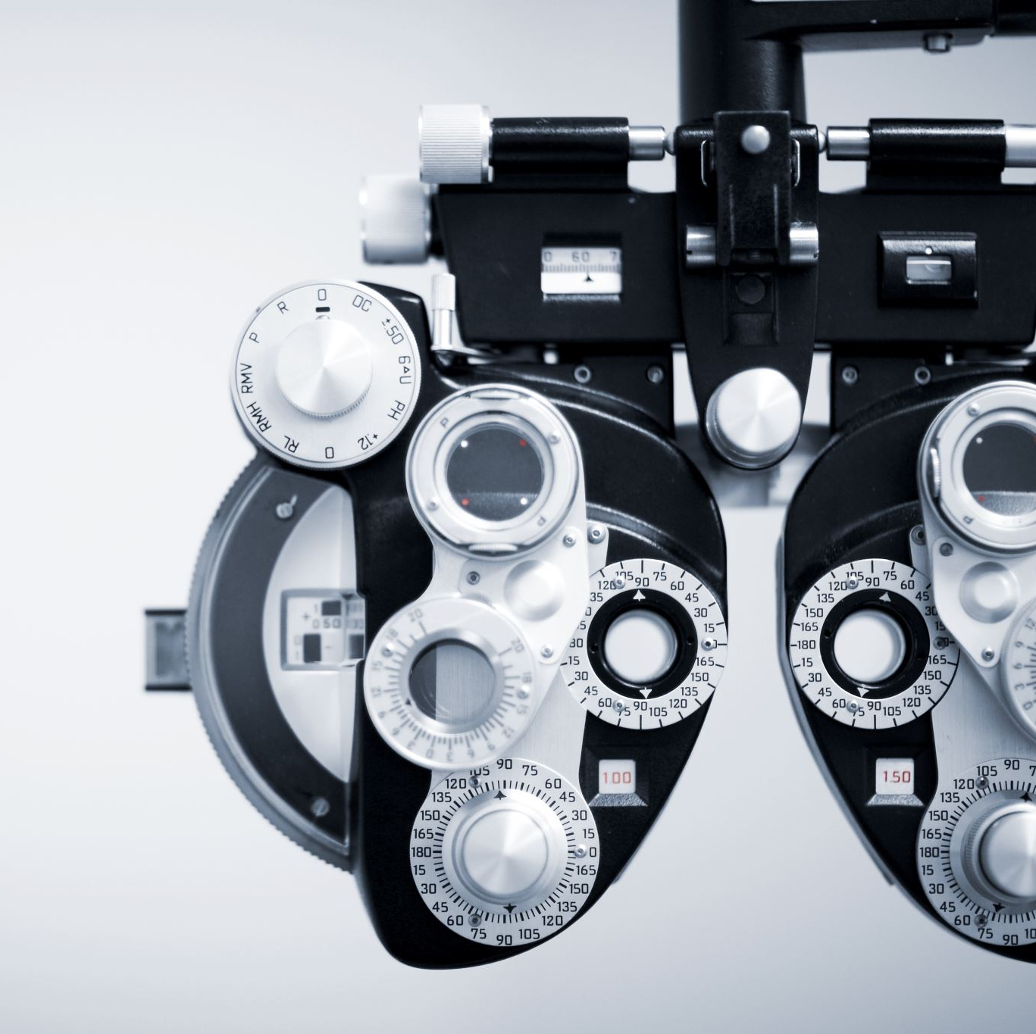
Drowsiness Detection Program
Drowsiness detection is an important application in the field of driver safety and can be implemented using computer vision techniques to analyze facial features and monitor eye behaviors offered by Python’s libraries like OpenCV, Tensorflow and Keras.

Slide 3

Breakdown of Drowsiness Detection Program
Face Detection
Eye Detection
Eye Tracking
Drowsiness Detection
Alert Mechanism
Real-time processing
Testing and Evalutation

Slide 4
Why Drowsiness Detection Program?
Drowsiness can impair a driver's ability to react quickly to unexpected situations, increasing the risk of accidents.
This is where drowsiness detection Comes in - it can accurately detect signs of drowsiness and alert drivers to take a break or rest. It can help prevent accidents caused by driver fatigue and improve overall road safety
Drowsiness Detection can also lead to reduced healthcare costs, as accidents caused by driver fatigue often result in serious injuries and hospitalizations. In addition, it can improve productivity and efficiency in industries that rely on transportation, such as logistics and delivery
Can have applications in other domains as well, such as in workplace safety, industrial settings, and other scenarios where alertness and attentiveness are critical for avoiding accidents and ensuring optimal performance.

Slide 5
Libraries used
Tensorflow
Keras
OpenCV
NumPy
Random
OS
PyGame
Time

Slide 6
Flow chart of Logic
Capture
Capture video or image frames: The program captures video or image frames from a camera or other source.
Detect
Detect face: A pre-trained face detection model is used to detect the face region within the captured frame.
Extract
Extract eye regions: The eye regions are extracted from the detected face region, typically by identifying the locations of the eyes using facial landmark detection or pre-trained eye detection models.
Track
Track eye movement and behavior: The program tracks the movement and behavior of the eyes over time, which may include monitoring parameters such as eye closure duration, blink frequency, and eyelid movement.
Analyze
Analyze eye tracking data: The eye tracking data is analyzed to determine if the driver's eyes are showing signs of drowsiness, such as prolonged eye closure, low blink frequency, or reduced eyelid movement.
Determine
Determine drowsiness: The program compares the eye tracking data against predefined thresholds to determine if the driver is drowsy or not.

Slide 7
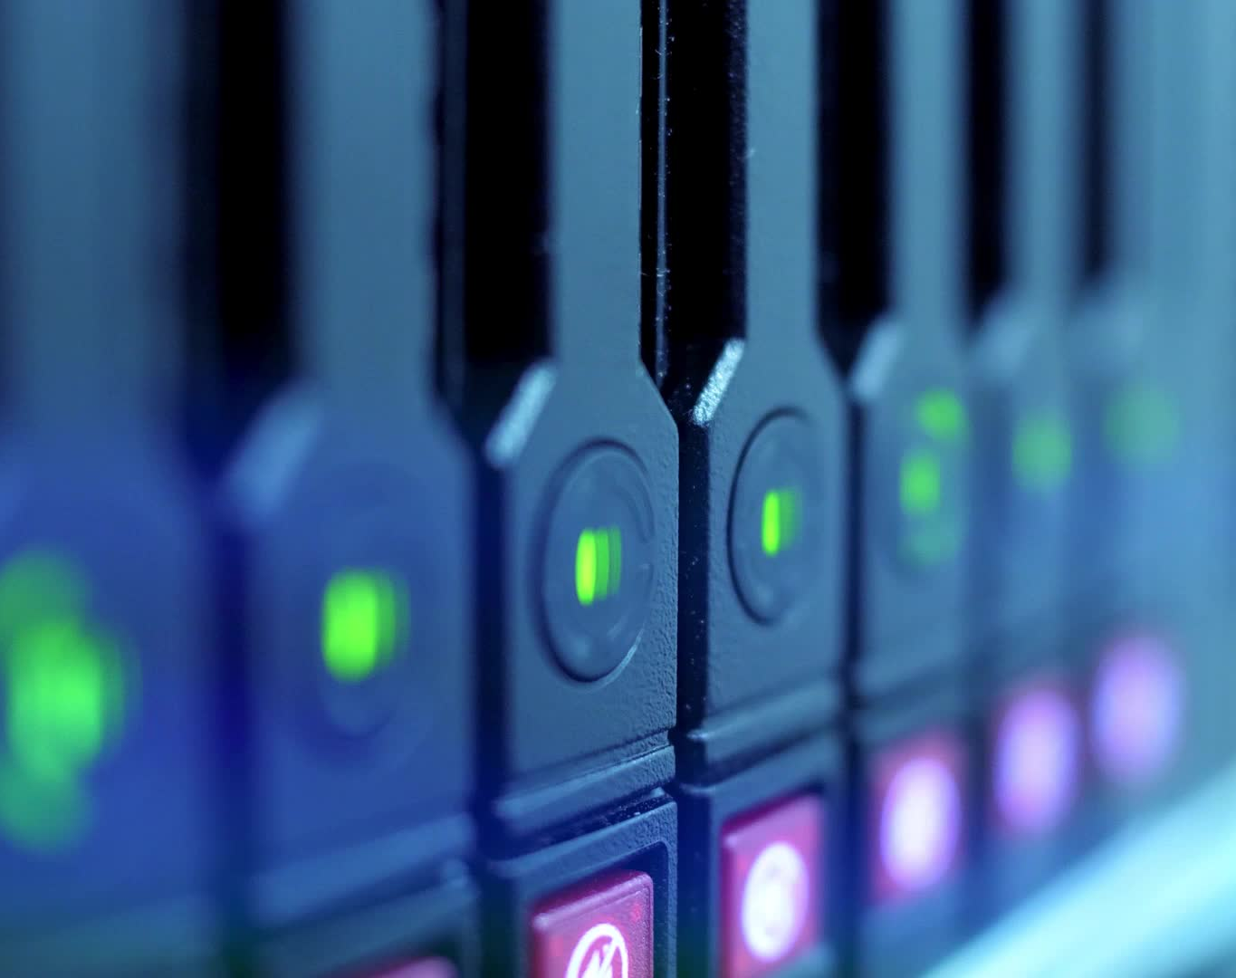
Flow chart of Logic
Alert mechanism: If drowsiness is detected, the program triggers an alert mechanism, which may include displaying a warning message on a screen or sounding an alarm to alert the driver.
Repeat for next frame: The program continues to capture and analyze video or image frames in real-time to provide timely alerts as needed.

Slide 8
HARDWARE ENGAGEMENTS
Some common hardware components that can be used in a drowsiness detection system include:
Cameras
Infrared Sensor
Accelerometers

Slide 9


Scope for Future Improvements
Real-time monitoring
Personalization
Integration with other safety systems
Collaboration with automakers
Application in other industries

Slide 10

THANK YOU

